Slide 1
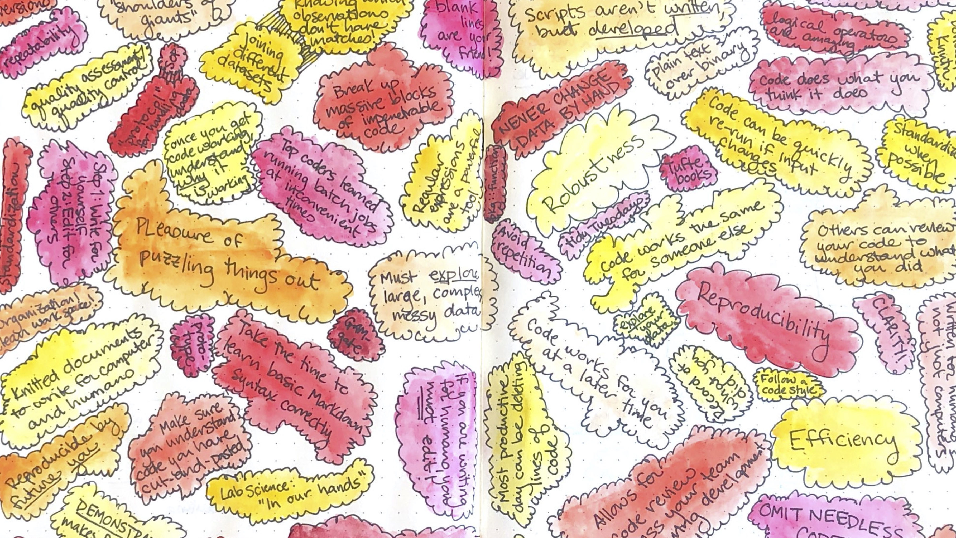
Rigor and Reproducibility in Coding
Brooke Anderson, Colorado State University

Slide 2

Reproducibility / Replicability

Slide 3

Computational reproducibility
“Reproducibility is obtaining consistent results using the same input data; computational steps, methods, and code; and conditions of analysis… Reproducibility is strongly associated with transparency; a study’s data and code have to be available in order for others to reproduce and confirm results…
Replicability is obtaining consistent results across studies aimed at answering the same scientific question, each of which has obtained its own data.”
– National Academies of Sciences, Engineering, and Medicine. 2019. Reproducibility and Replicability in Science. Washington, DC: The National Academies Press. https://doi.org/10.17226/25303.

Slide 4
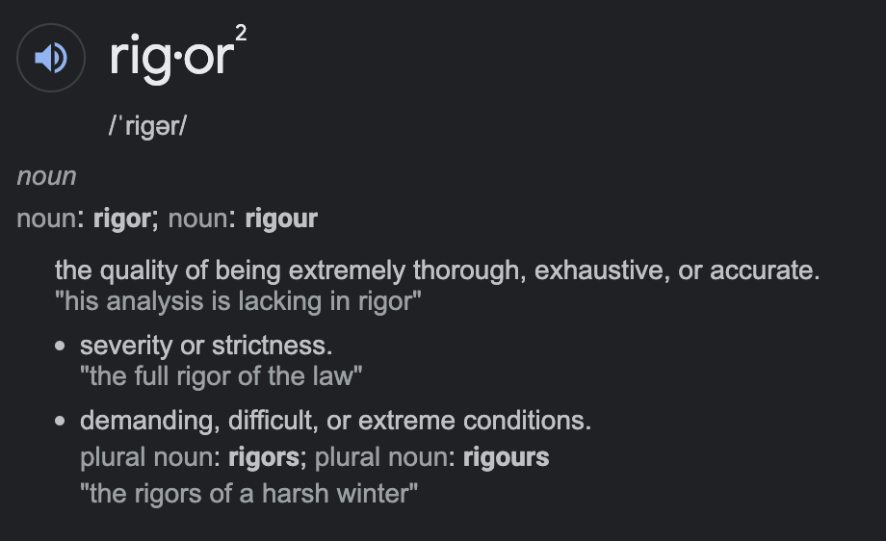
Rigor

Slide 5


Computational rigor

Slide 6
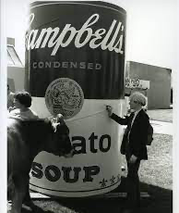
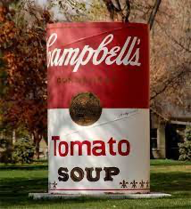
Efficiency
“This work was created by the Department of Art in 1981 in association with the exhibition Warhol at Colorado State University and according to the specifications and directions of Andy Warhol. Upon his arrival in Fort Collins in September of 1981, Warhol signed the work.”

Slide 7
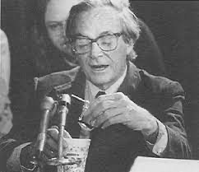
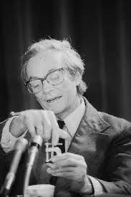
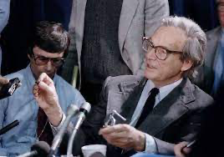
Demonstration
“The public saw with their own eyes how science is done, how a great scientist thinks with his hands, how nature gives a clear answer when a scientist asks her a clear question.”
– Freeman Dyson, on Richard Feynman’s demonstration of O-rings in Presidential Commission for the space shuttle Challenger disaster

Slide 8
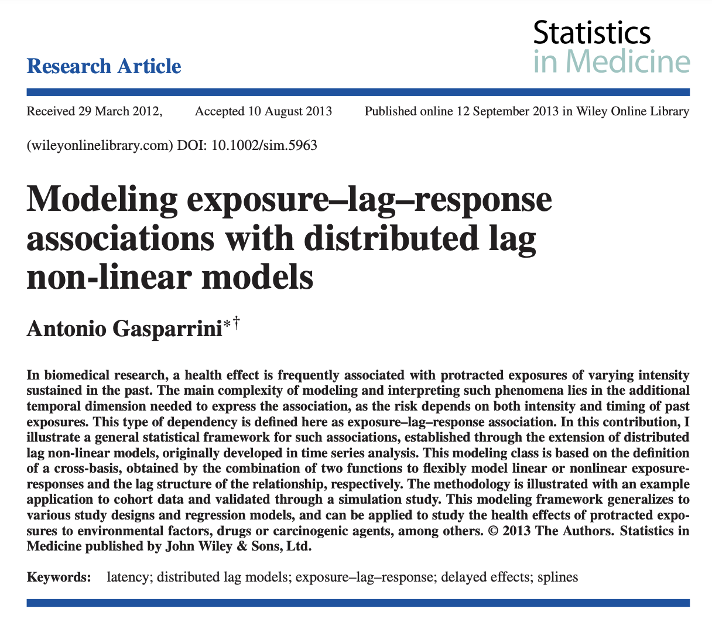
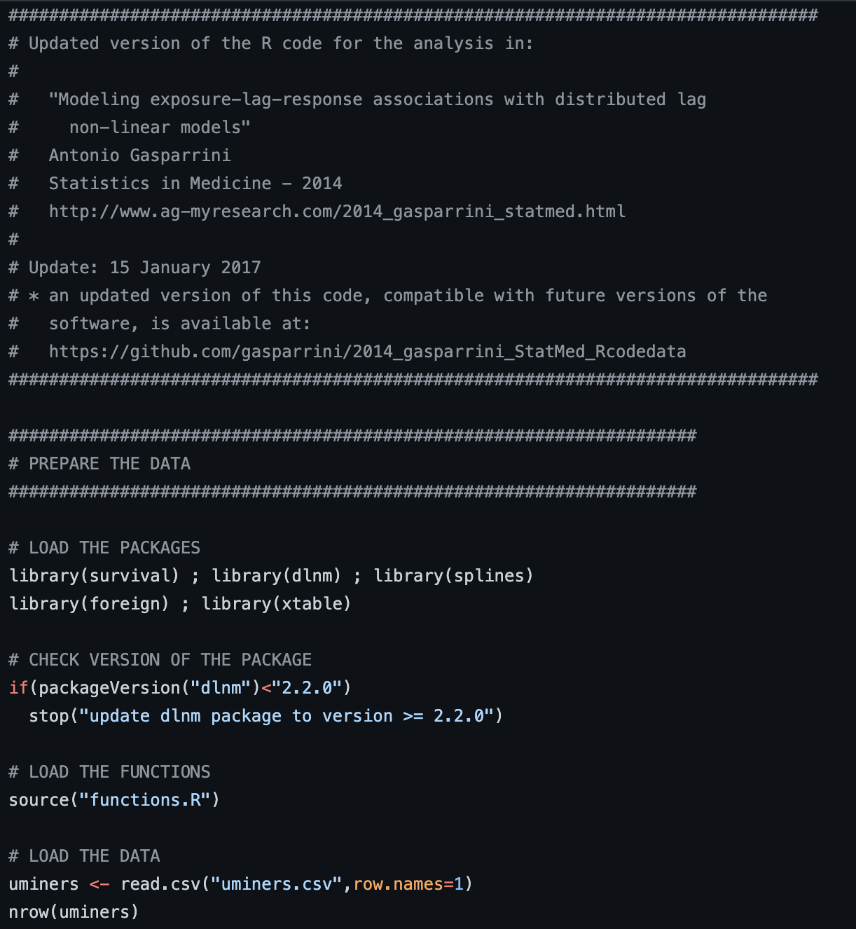
https://github.com/gasparrini/2014_gasparrini_StatMed_Rcodedata

Slide 9
Computational reproducibility
If you start from the same materials, you can get the same results
Who might reproduce your code? Colleagues in your research group, reviewer, reader, you in the future
“Reproducibility” is both binary and continuous:
Binary: Can you recreate the results from the same original data?
Continuous: How easy is it to recreate the results? How easy is it to understand what you did? Can you adapt and extend your approach? Can you and others critically evaluate or check it to improve the rigor? Can it serve as a demonstration for others, not just an analysis for you?

Slide 10
Improving reproducibility in research code
What we’ll talk about next:
You have learned how to code with a language like R, and how to save that code in a script. In theory, you can meet the binary definition of reproducibility.
How can you improve the computational reproducibility of your code on the continuous scale?
My perspective:
Instructor of course in R Programming for Research for many years
Research advisor to trainees learning to use code for large research projects

Slide 11
Six tips to improve the rigor and reproducibility of research code
1. Write code for computers. Rewrite it for humans
1
2. Omit needless code.
2
4. Find your favorite tools. Learn to use them well.
4
5. Organize, consistently.
5
6. Learn some magic.
6
3. Don’t reinvent the wheel… but do learn why it works
3

Slide 12


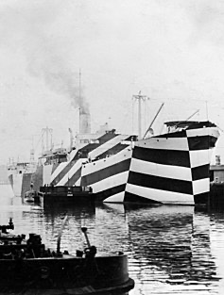

Write code for computers. Rewrite it for humans.

Slide 13
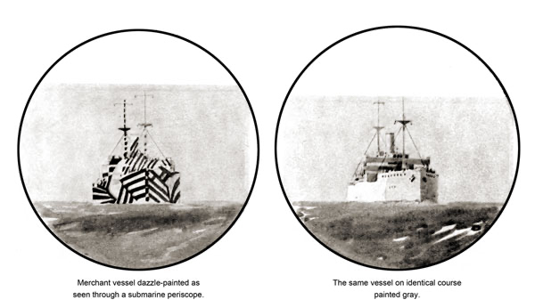
Dazzle Camaflouge

Slide 14
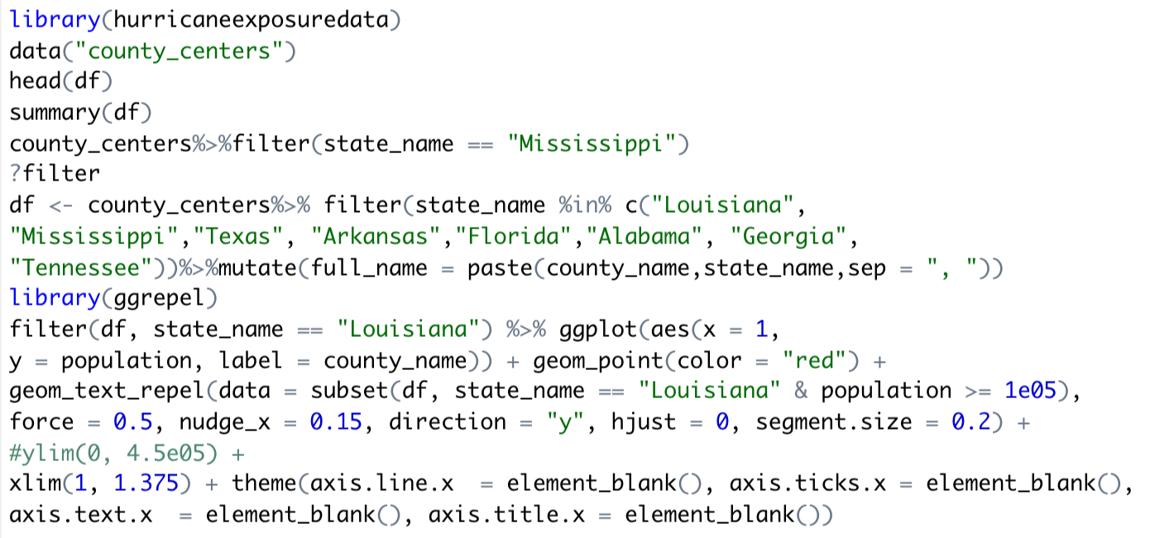
Dazzle Camaflouge

Slide 15
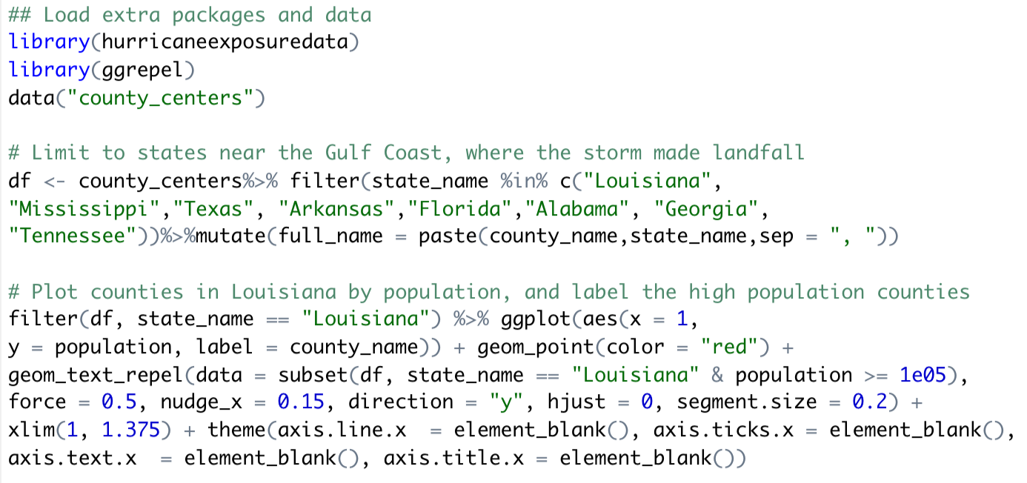
Provide structure for readers
Code divided into labeled sections
Blank lines used to separate sections

Slide 16
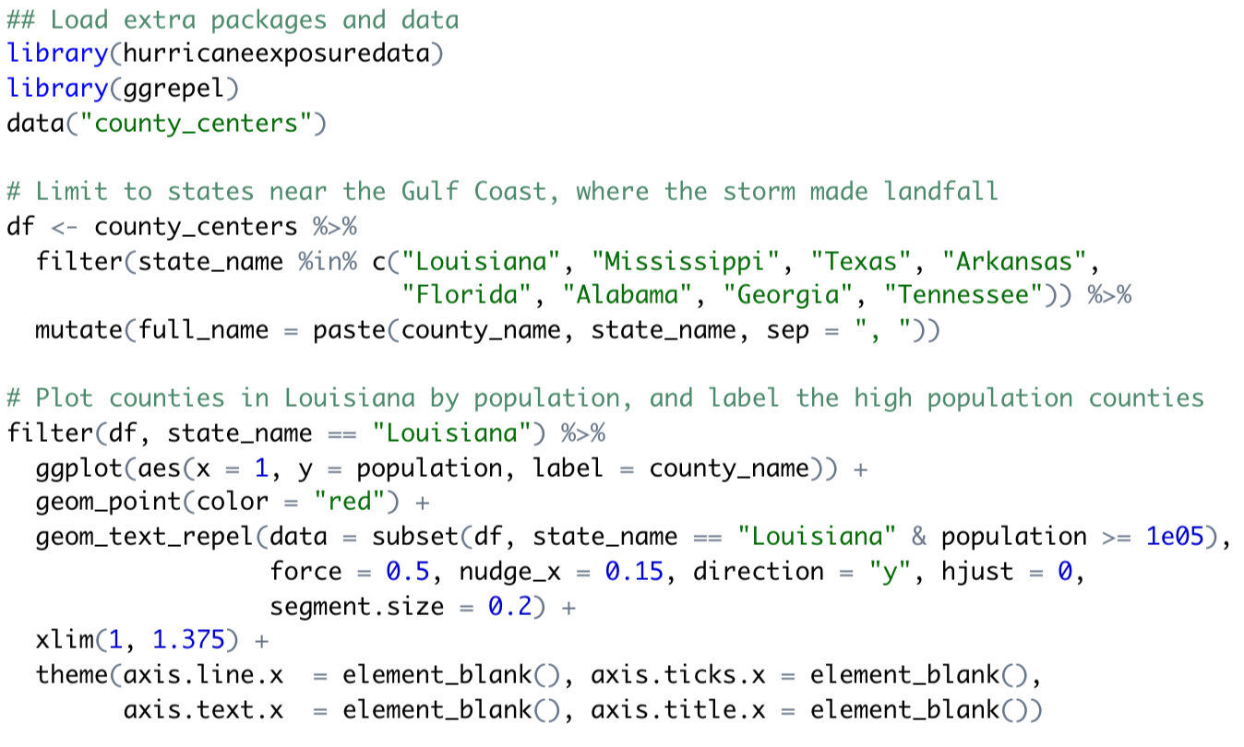
Follow a code style guide

Slide 17
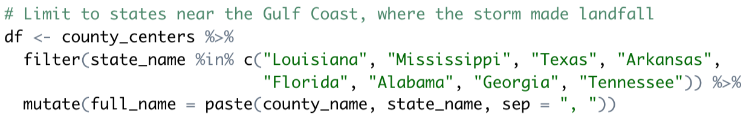
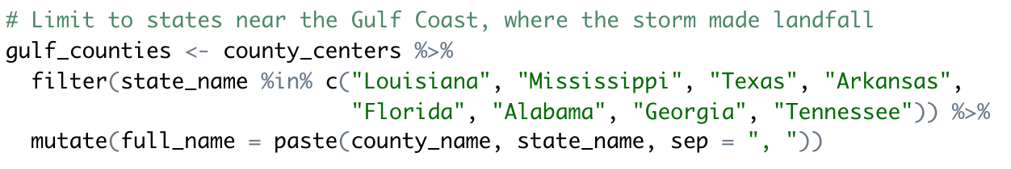
Use meaningful object names
Generic object name
Descriptive object name

Slide 18
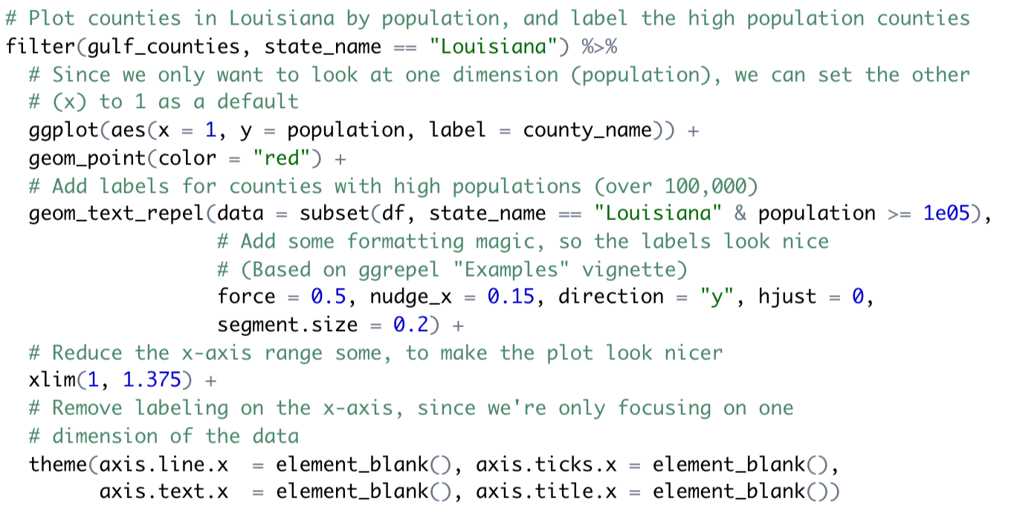
Add code comments

Slide 19
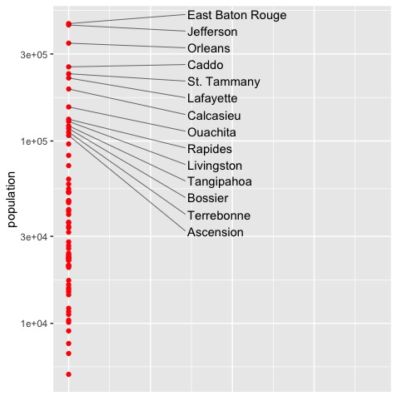
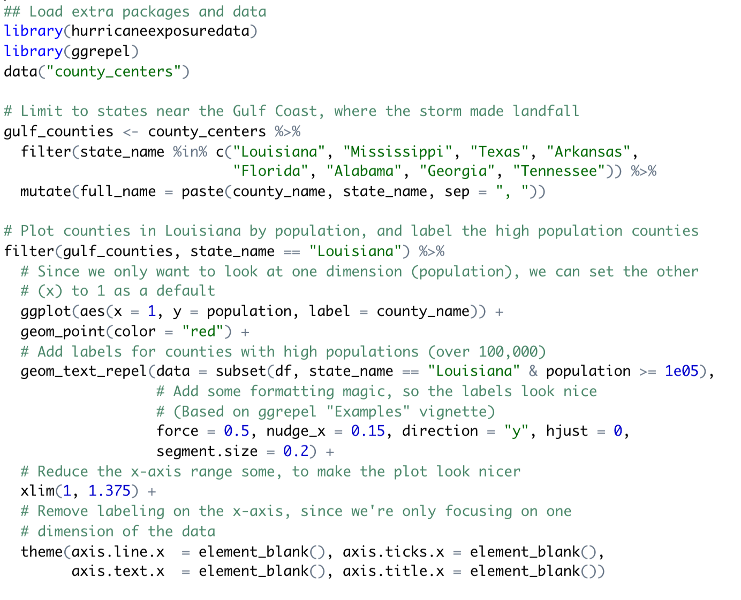

Slide 20
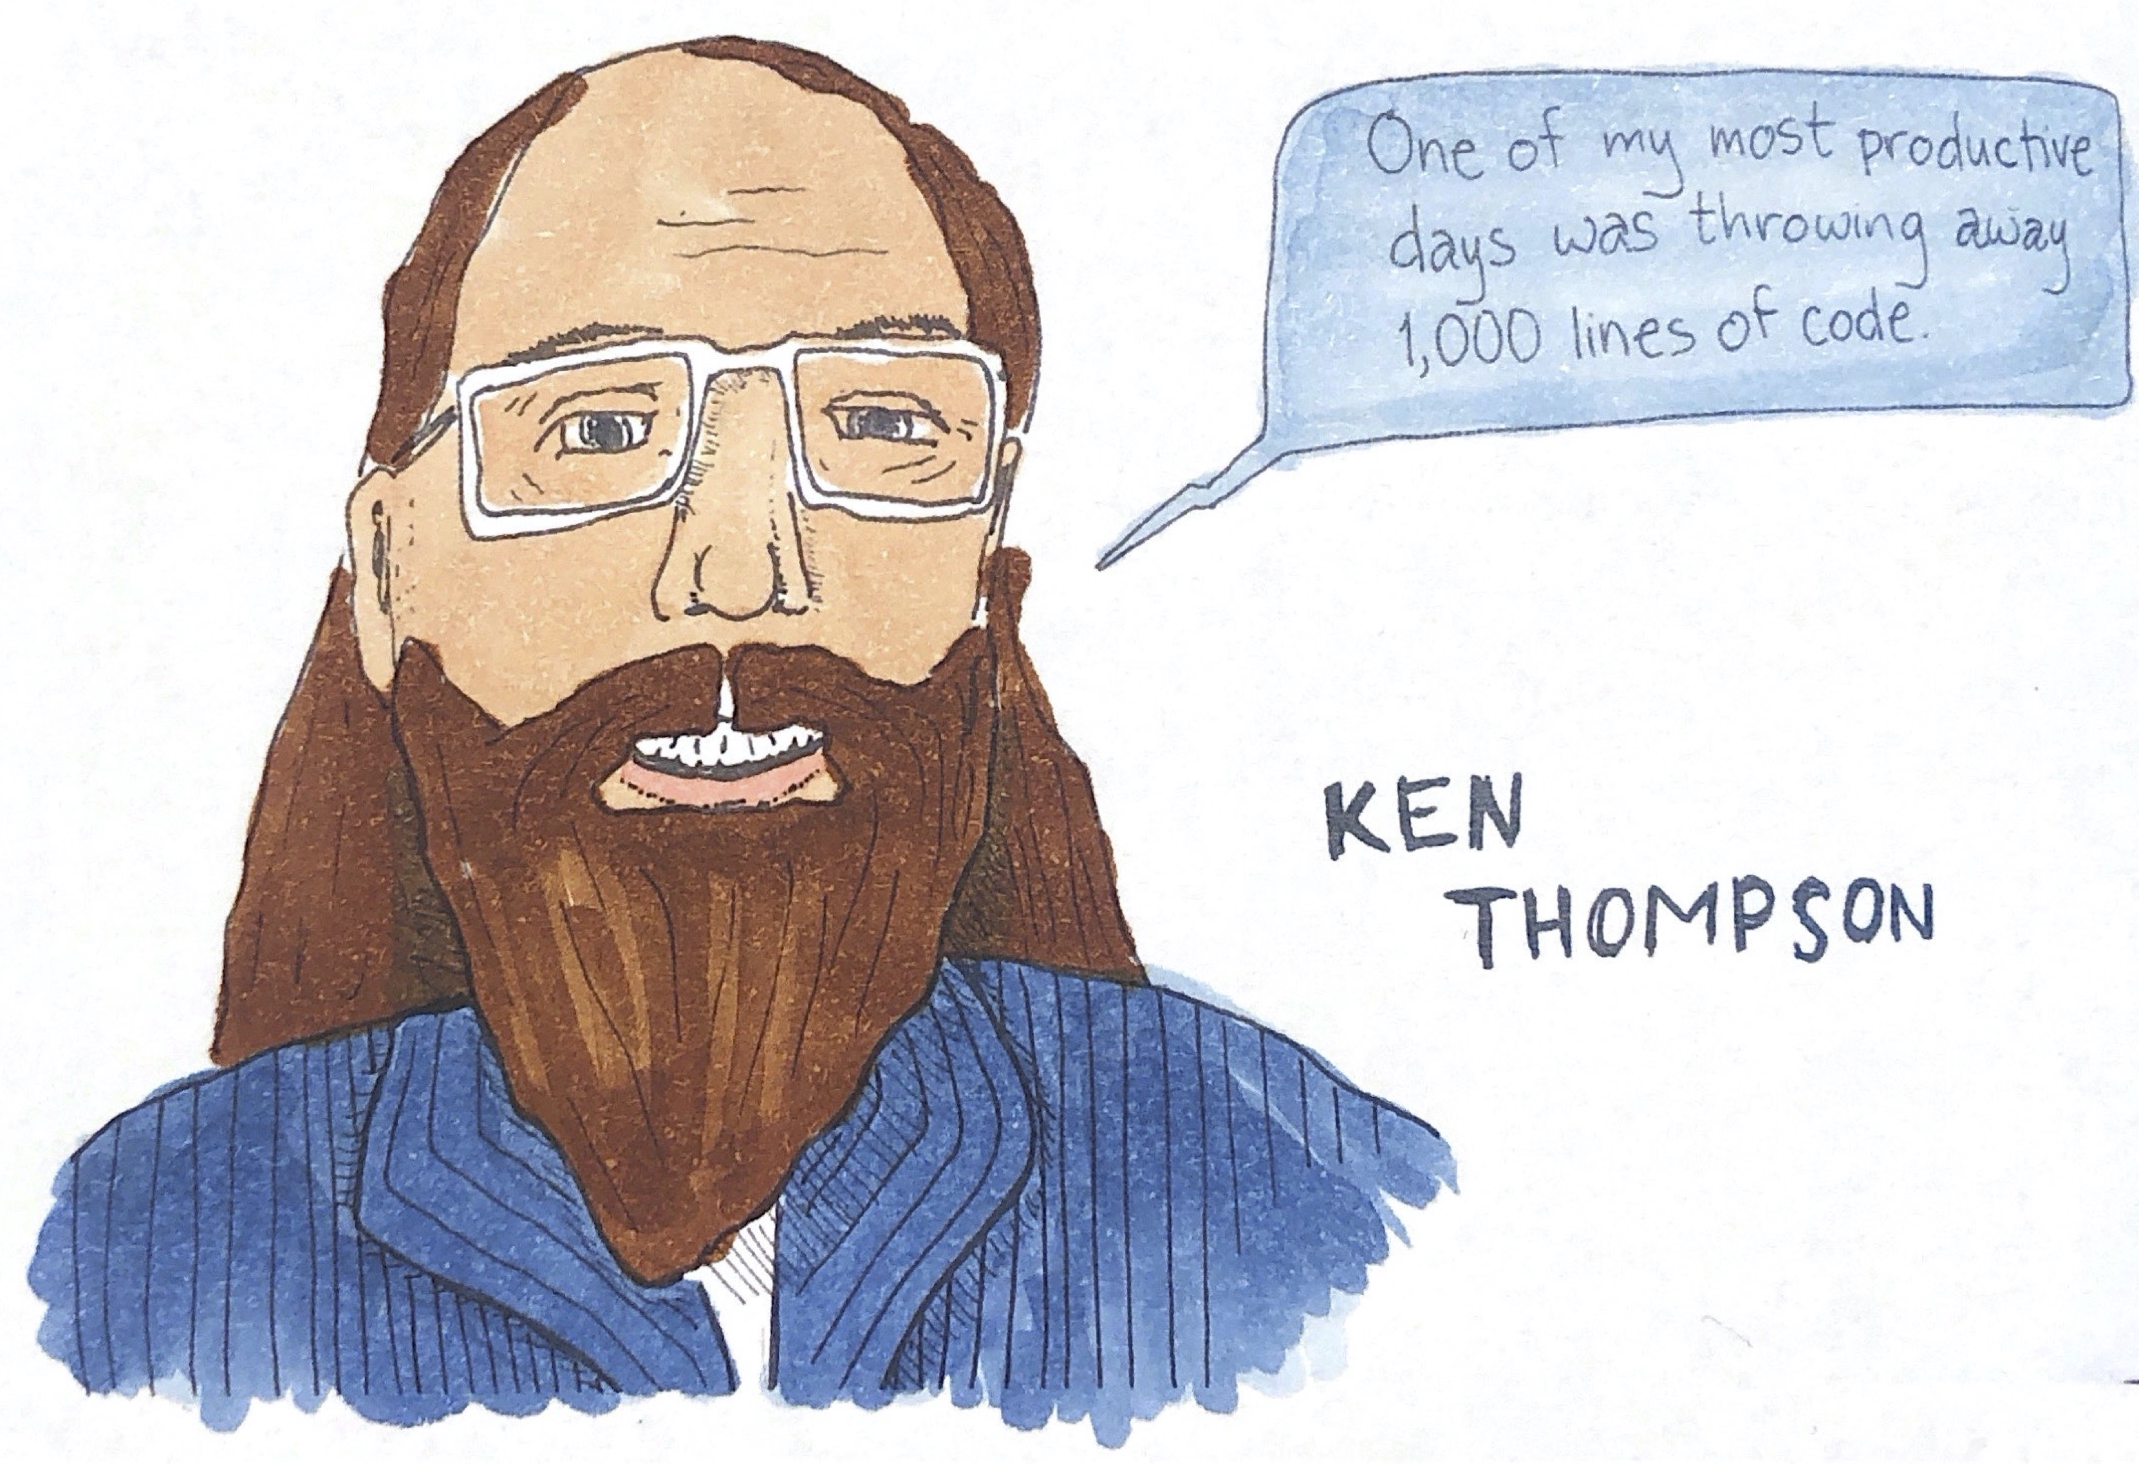
Omit needless code

Slide 21
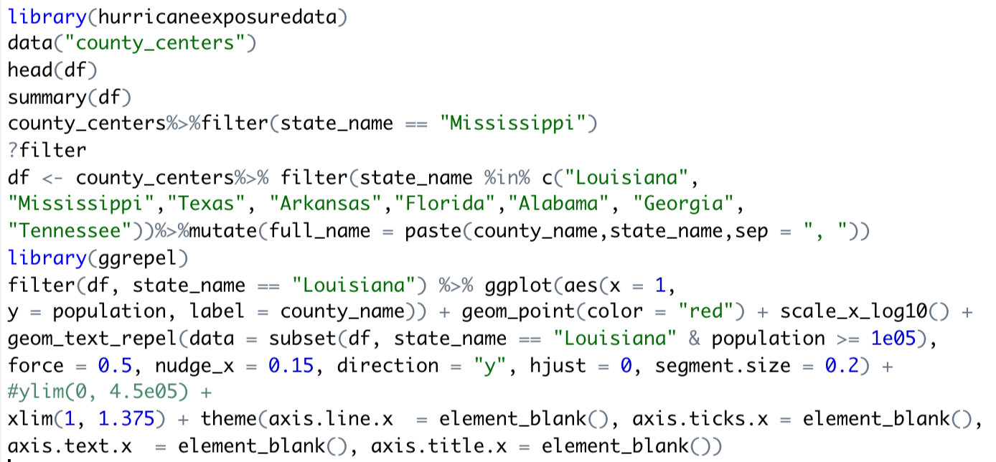
Remove dead-end code
Explored the data
Checked a helpfile
Decided not to use this piece of code

Slide 22
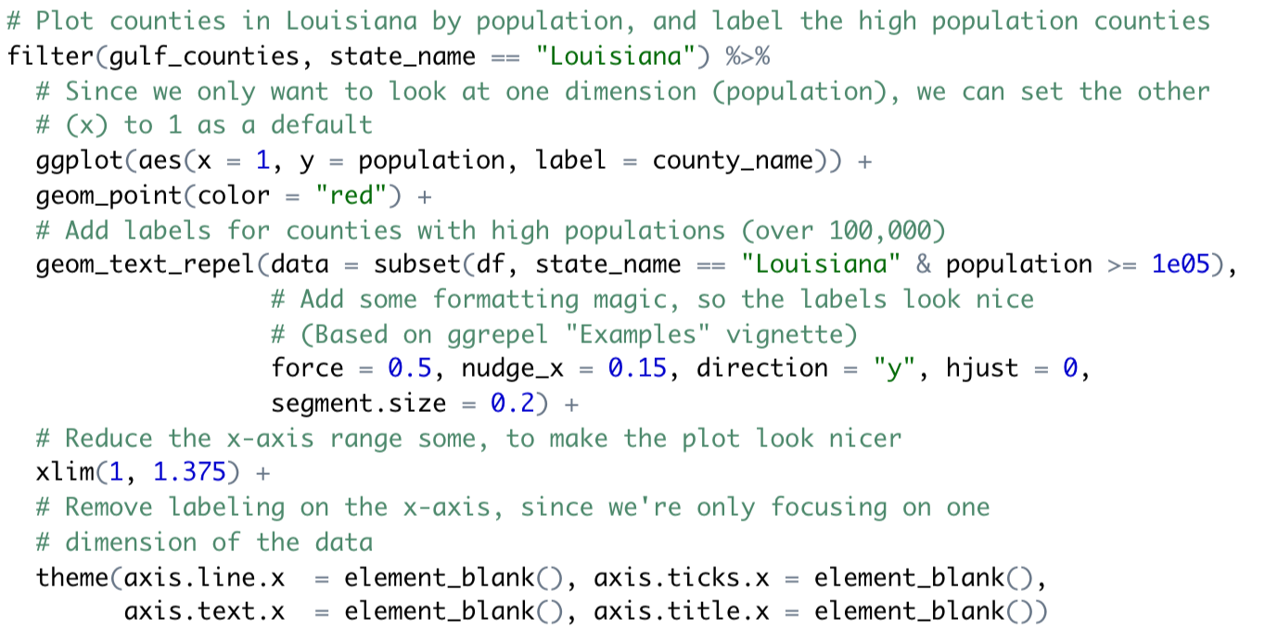
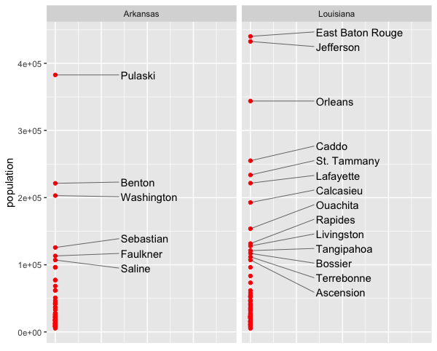
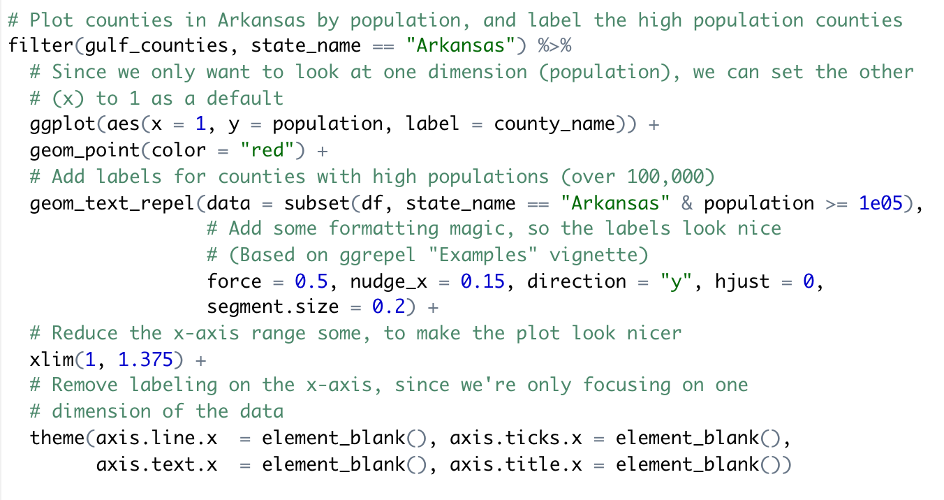
Revise code that repeats

Slide 23
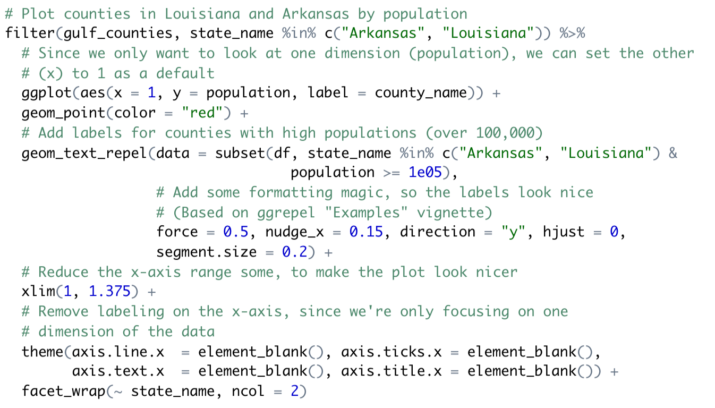
Revise code that repeats
Work with both states at once
Facet by states to create one plot per state

Slide 24
Revise code that repeats
Learn to write code that applies the same function or process across groups:
faceting in `ggplot2`
the `map` family of functions in `purrr`
the `group_by`-`summarize` workflow in `dplyr`
Write small functions to encapsulate code you repeat

Slide 25
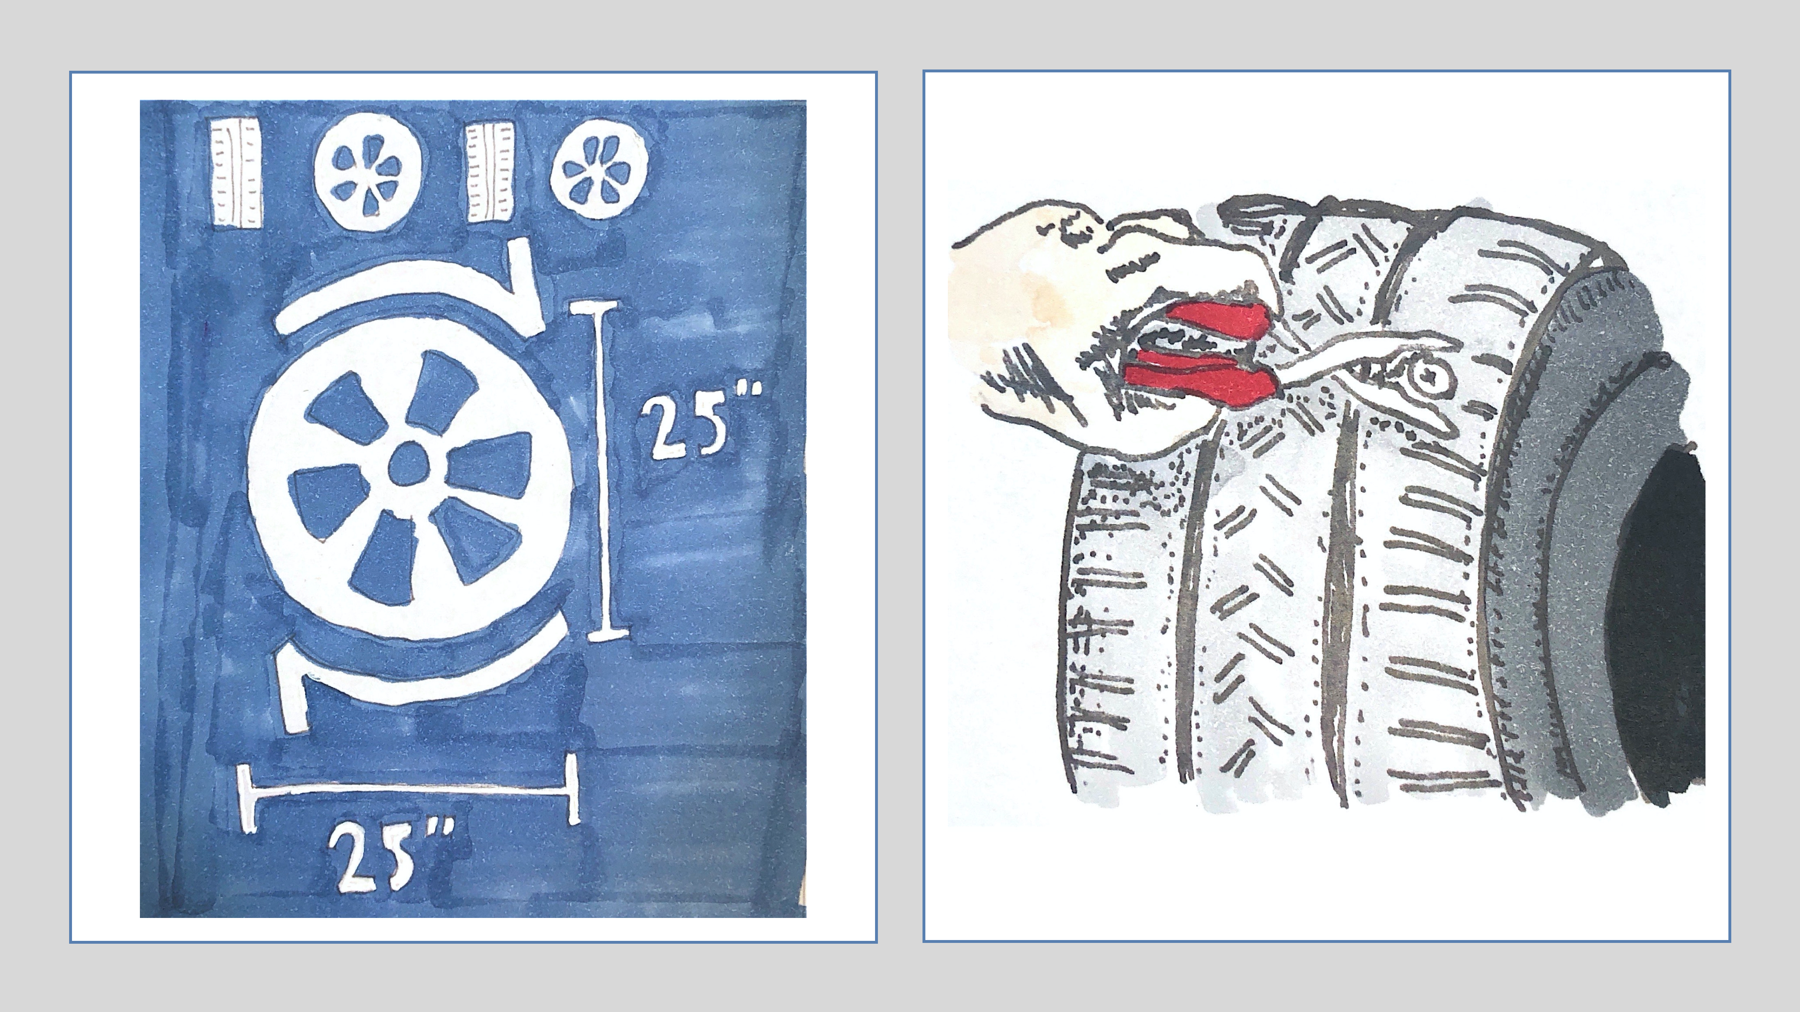
Don’t reinvent the wheel… …but do understand how it works

Slide 26
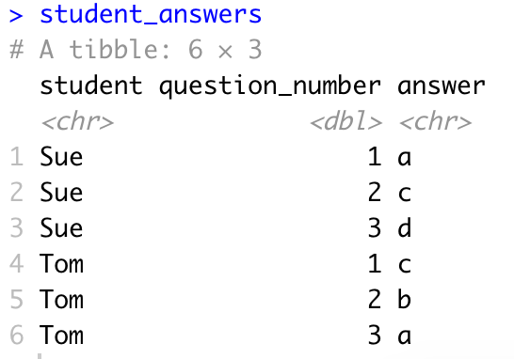
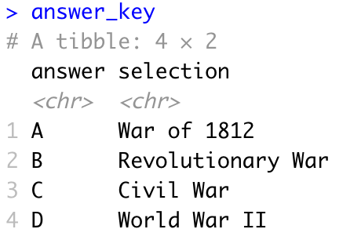
Look for solutions online when you get stuck
Problem: You need to merge two datasets by the “answer” column, but the capitalization is different, so R doesn’t recognize the matches.
We want to join based on the “answer” column

Slide 27
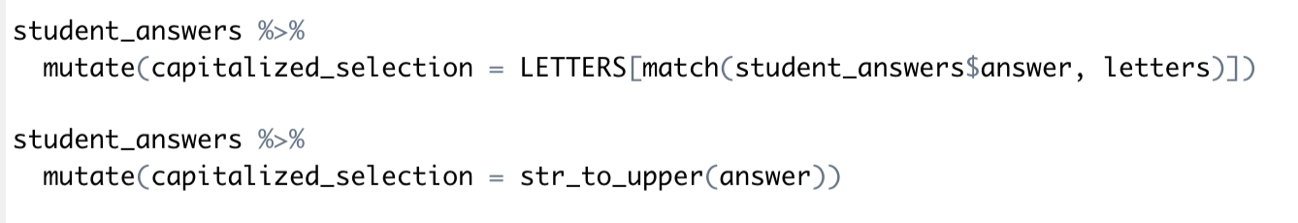
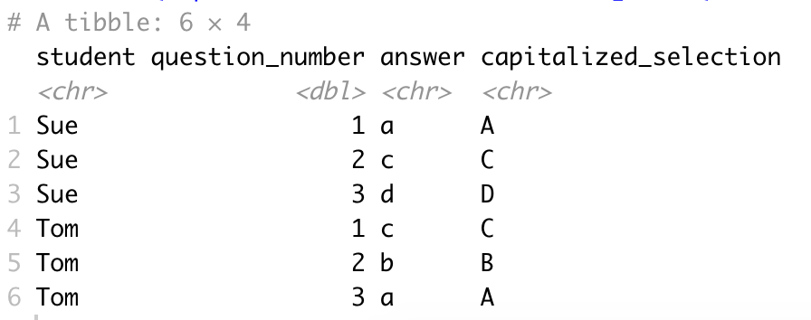
Look for solutions online when you get stuck
Solution: You googled the problem and found an idea on StackOverflow to change the lowercase letters to uppercase before we merge:
It works!:

Slide 28
Look for solutions online when you get stuck
Why does it work?
A built-in dataset of capital letters
A built-in dataset of lowercase letters
Square brackets let you extract values from a vector by position
A function that returns numbers with the location of where there are matches for one vector in another

Slide 29
Look for solutions online when you get stuck
Better solution: We used the idea of changing to lowercase, but we found a process we understand better to do it:
It works! And we know why!:

Slide 30
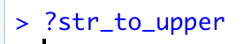
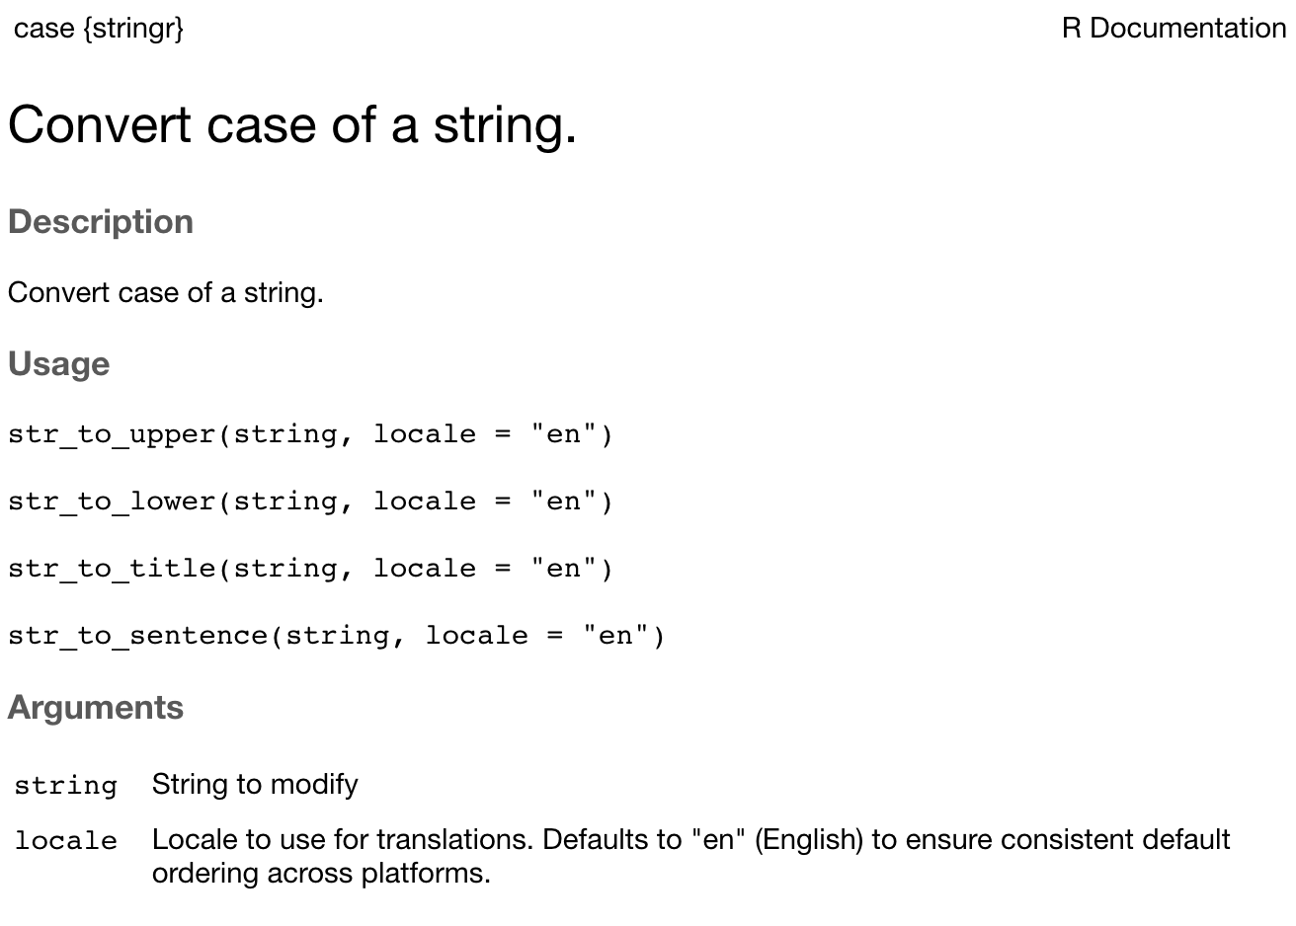
Dive into documentation
What parameters does the function have?
What values can you give those parameters?

Slide 31
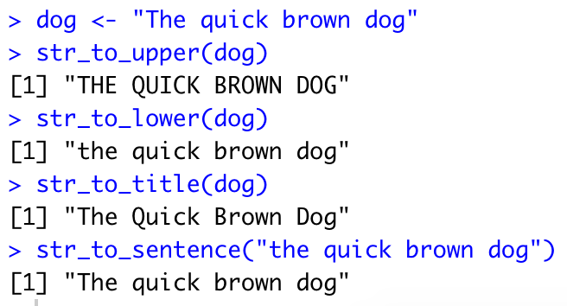
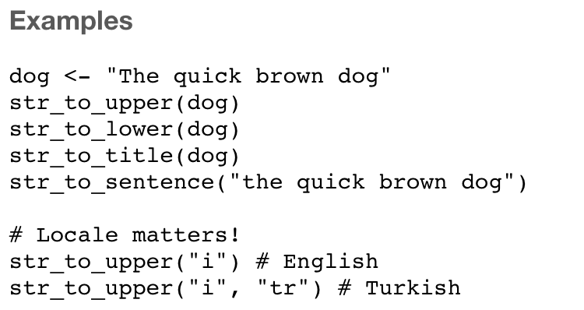
Dive into documentation
How can you use this function?

Slide 32
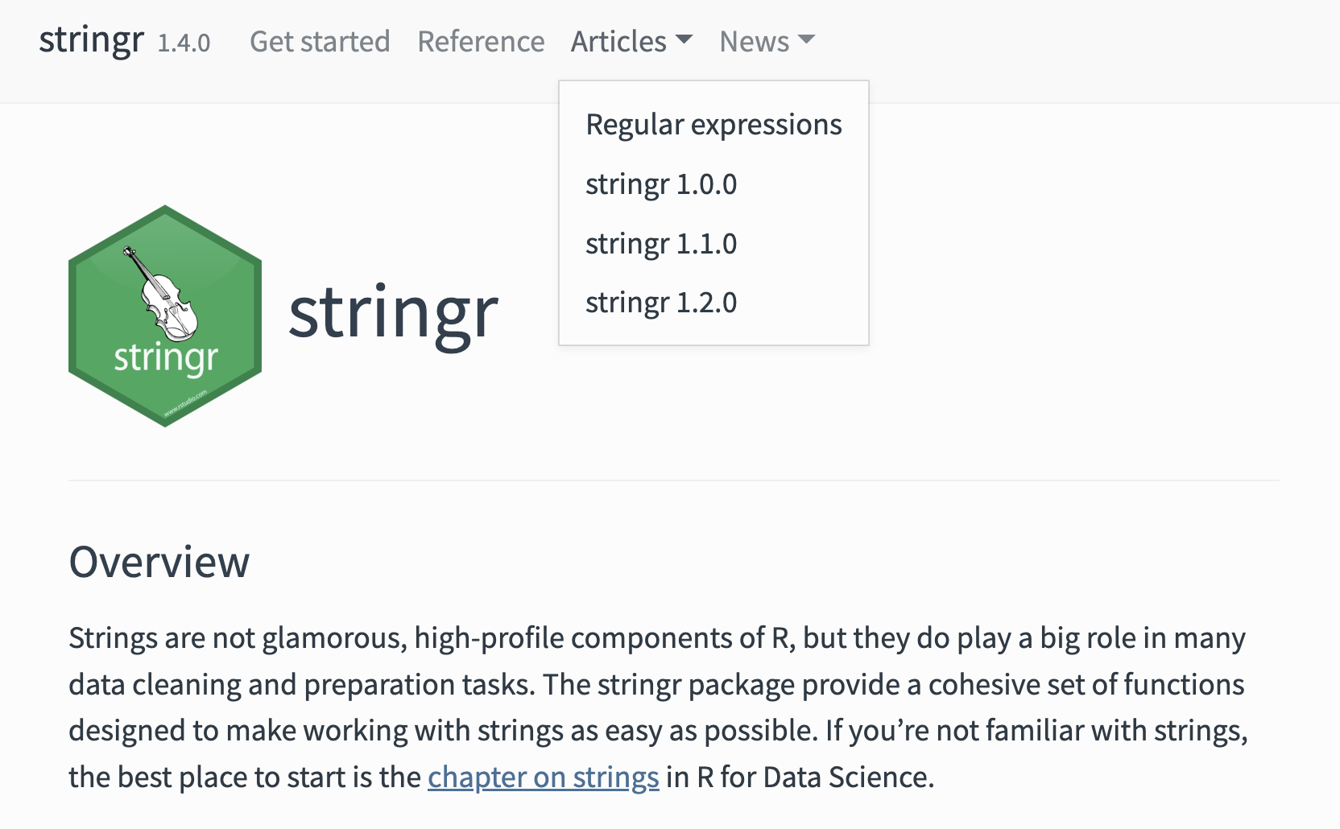
Dive into documentation
https://stringr.tidyverse.org/

Slide 33
Dive into documentation
https://www.rstudio.com/resources/cheatsheets/

Slide 34
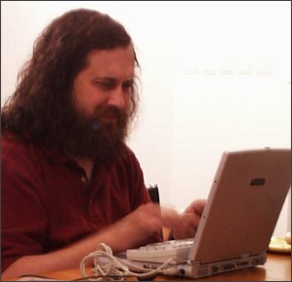




Find your favorite tools. Learn to use them well.

Slide 35

Tidy data structure
Wickham, H. . (2014). Tidy Data. Journal of Statistical Software, 59(10), 1–23. https://www.jstatsoft.org/article/view/v059i10

Slide 36
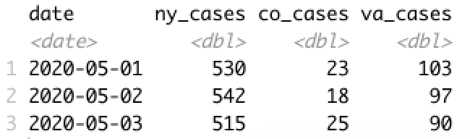
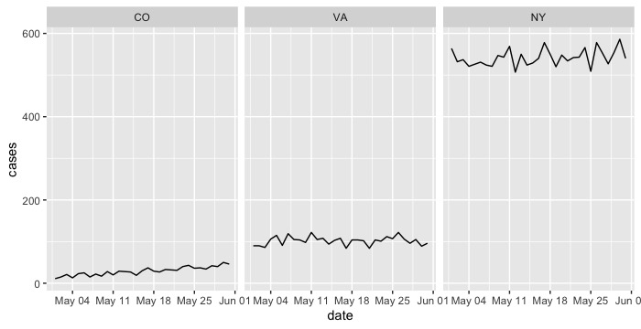
Tidy data structure
Data we have
Plot we want

Slide 37
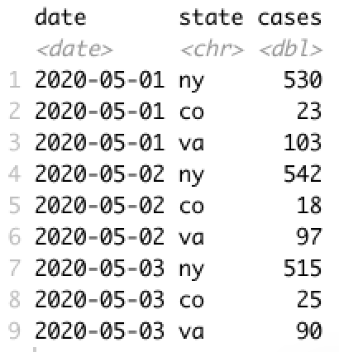
Tidy data structure
Convert to “tidy” structure
Then plotting is simple

Slide 38
Regular expressions
“county_name”
New Orleans
Orleans Parish
Dare County, NC
Orleans, LA
Larimer, CO
orleans, la
dare, nc
Find all the values in the vector that match a certain pattern
“^[oO]rleans”
New Orleans
Orleans Parish
Dare County, NC
Orleans, LA
Larimer, CO
orleans, la
dare, nc

Slide 39
`stringr` package
Subset to only the values that are matches
str_subset(county_name, pattern = “[oO]rleans”)
Orleans Parish
Orleans, LA
orleans, la
Create a logical vector that states whether the value at that position was a match
str_detect(county_name, pattern = “[oO]rleans”)
FALSE
TRUE
FALSE
TRUE
FALSE
TRUE
FALSE

Slide 40
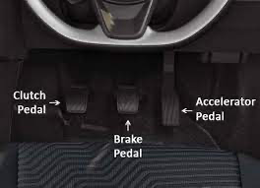
Organize, consistently

Slide 41

Organize, consistently
Package
countytimezones
data
data-raw
DESCRIPTION
man
R
vignettes
Package
hurricaneexposure
DESCRIPTION
man
R
vignettes
Package
noaastormevents
DESCRIPTION
man
R
tests
vignettes
Package
stormwindmodel
data
data-raw
DESCRIPTON
man
R
src
tests
vignettes

Slide 42
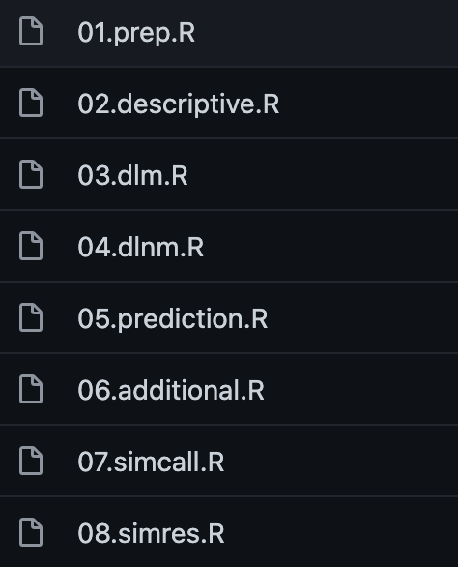
Organize, consistently
Put all code, data, and output for a project in a single directory
Organize that directory into subdirectories
Name those subdirectories consistently
Use meaningful file names
Remove unnecessary files
Learn to use version control (git)
https://github.com/gasparrini/2014_gasparrini_StatMed_Rcodedata

Slide 43

Learn some magic

Slide 44
All of a sudden my code doesn’t work, and I haven’t changed a thing!

Slide 45
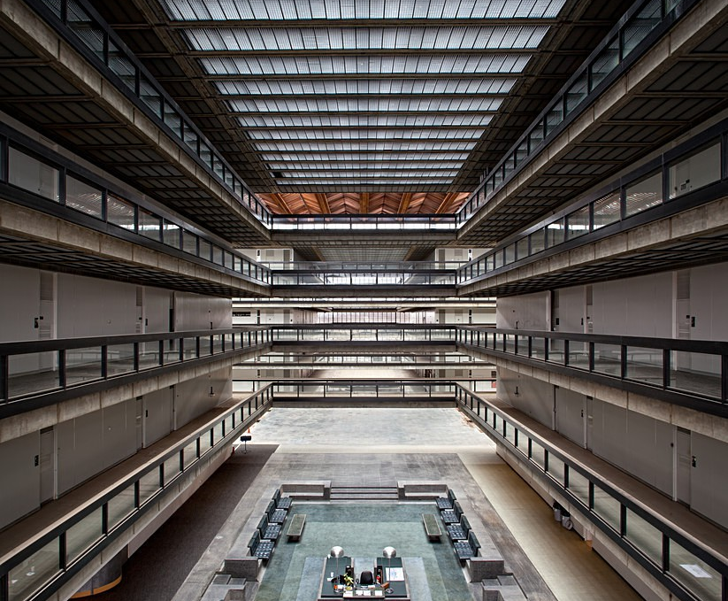
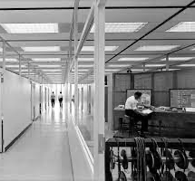
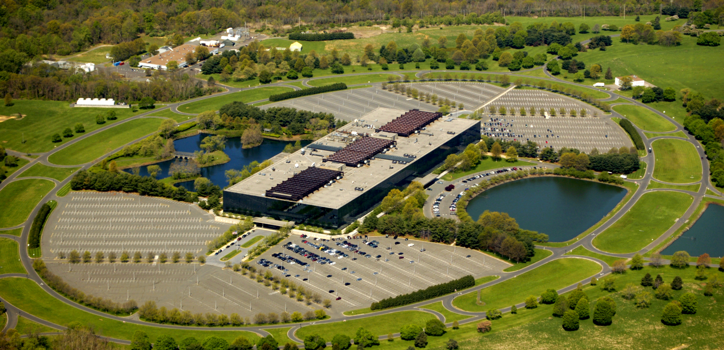
Bell Labs

Slide 46
Learn some magic
Learn about file directory structure, and leverage it by keeping project code in R Projects
Learn about working directories, and keep yours in the top level of an R Project
Use relative pathnames to reference other files in your R Project
Don’t rely on .Rhistory or objects you created in the console---make all objects you need in the script
Get in the habit of trying code in a “fresh” environment
Learn about namespaces (and always mistrust `filter`!)

Slide 47
Suggested resources to learn more
Google R code style guide: https://google.github.io/styleguide/Rguide.html
Articles:
Example of reproducible paper: A. Gasparrini. 2013. Modeling exposure–lag–response associations with distributed lag non-linear models. Statistics in Medicine.
H. Wickham. 2014. Tidy Data. Journal of Statistical Software.
Organizing research projects
Books available online:
R for Data Science, Wickham and Grolemund, https://r4ds.had.co.nz/
Geocomputation with R, Lovelace et al., https://geocompr.robinlovelace.net/
Data Visualization, Healy, https://socviz.co/
Text Mining with R, Silge and Robinson, https://www.tidytextmining.com/
Rmarkdown, The Definitive Guide, Xie et al., https://bookdown.org/yihui/rmarkdown/
Other books:
Reproducible Research with R and RStudio, Gandrud
Edward Tufte visualization books
Anything on regular expressions
Introductory Unix / shell coding books
Packages to learn well:
tidyverse suite of packages, including dplyr, purrr, tidyr, stringr, forcats, and lubridate
For spatial data, sf
For visualization, ggplot2 extensions, htmlwidgets, ggrepel

